Slide 1
Storage in Cloud
Adventure with
Mikhail Mikhailovich Pomortsev
(sort of, or not)
via Jens Jensen, STFC...
NGS surgery, 2011-02-09

Slide 2
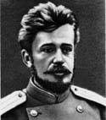
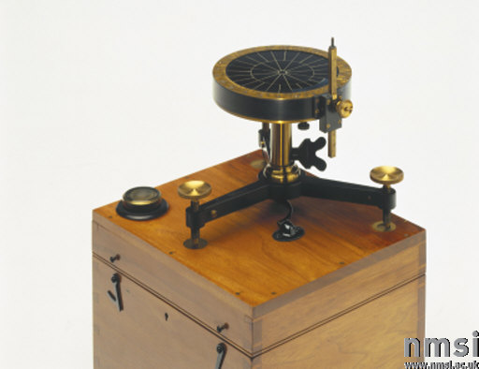
Who is famous scientist, Pomortsev?
I invented the Nephoscope
Nephoscope measures position, velocity, and altitude of clouds

Slide 3
What is thing, cloud?
Simple *cough* API (SOAP, ReST)
Elastic – scales on demand
Rapid allocation of resources
Accounted
“In the cloud” - don't know where service is
Networked
And don't care, like the grid
Resource pooling (“multi-tenancy”)

Slide 4
Clouds, what types they are?
Public – Rackspace, Azure, etc
Private – er, private
Community – shared, like NGS
Hybrid – er, hybrids

Slide 5
Cloud, Grid, what is difference?
In grids, you can control brokering
More parameters for resource selection
Can request – or locate – resources
In grids, you can have big resource
Dedicated grid resources

Slide 6
Examples
Not even pretending to be complete set of

Slide 7
Rackspace
Java, Python, .NET, Ruby, PHP
ReST API
Can return JSON as well as XML
Containers for data
String-based “directory” support
Foundations for OpenStack
Account
Containers
Objects

Slide 8
Storage as PaaS: Microsoft SQL Azure
Azure is .NET based (but you can run other things)
Username/password for AuC
Port 1433...
Still need a DBA...
Certified data centres (SAS 70 Type 2)

Slide 9
Storage as PaaS: Hadoop
Part of Apache projects
Written in Java (1.6 req’d, Sun)
Integrates with MapReduce for computation
libhdfs for C (and stuff that links C)
“Pipes” execute (eg) C++ code
Makes use of topology for eg caching
Distributed: based on HDFS
Files are split into blocks
Can roll back upgrades
Can rebalance datanodes
Note: draining process

Slide 10
Amazon
File (data), metadata (k/v), permissions
Containers are called “buckets”
Addressing bucket as host or path
Keys index contents of buckets
String-based “directory” support
AuZ in HTTP header
Request id & other dbg info

Slide 11
Authentication
Amazon
User id + secret symmetric key, used with HMAC
Timestamp prevents replay

Slide 12
Cloud Limitations
Atomicity, clobber
Cost (of elasticity), limits to growth
Cf. JISC-funded Kindura project
No standard API
De-facto standards proprietary
Partial RFC 2616 (HTTP/1.1) support?
Hype
Good for some things, less suitable for others
No silver bullet
You don't really know what you get
Maybe not even after you've got it!

Slide 13
Storage Types
Constrained to geographic region
LOCKSS
Like SRM's Custodial vs Output/Replica
More in CDMI

Slide 14
Example – RAL's Atlas datastore
Cloudy for small customers
Just write stuff into the tapestore
Accounting by family and owner
Networked in various ways
Simple API? (E.g. CIFS mount.)
Griddy for large customers

Slide 15
CDMI
Cloud Data Management Interface

Slide 16
DaaS: CDMI
DaaS = Data storage as a Service
Caveat: there are other DaaS
SNIA
Based on existing standards eg IETF
ReST+JSON
Objects in containers
Capabilities and Accounting (pseudo)objects
Queue objects
Key/Value metadata

Slide 17
Legacy Access
Support existing clients:
Block: iSCSI
File: WebDAV, NFS, CIFS
OCCI (OGF)
XAM for metadata?

Slide 18
CDMI security
More extensive capabilities than other DaaS
Confidentiality in flight and at rest
AuC, AuZ, ACLs
Domains for data ownership and permission
Inheritance via hierarchy
Data integrity
Active protections: media scrubbing, malware detection
Audit trail

Slide 19
CDMI capabilities (implementation dependent)
Delayed creation
Optionally
Serialise/deserialise
Copy and move obj
Snapshots
Access obj range
(cf HTTP ranges)
“CDMI content-type”
Fields
Object hold
(Temp) read-only

Slide 20
CDMI Queue Objects
Notification – event FIFO
Logging – more detailed and restricted
Query queues – queue, er, queries
Async, as results are stored in an object

Slide 21
CDMI capability objects
High level
Mount/access capabilities
Security
Object types supported – queues, queries
Storage system – object metadata
Data system – redundancy, cksum, latency
Capabilities of objects, containers, domains, queues

Slide 22
CDMI status
SNIA reference implementation
In Java
Planned implementation in dCache

Slide 23
Related Work
Lots of EU-funded activity
Contrail – federated cloud access
Storage: GAFS (based on XtreemFS) and Hadoop
StratusLab

Slide 24
What use this thing, cloud?
Pomortsev was originally interested in aeronautics, artillery, and missiles
We are interested in clouds:
As a means to do things
Better?
The challenge:
Keep track of all activites
Stay on the frontier (of what?)
Make use of the best suited
But we need to understand the problem (cf flexible serv.)

