Slide 1
Cloud Standards Interoperability: Status Update on
OCCI & CDMI Implementations
Florian Feldhaus
TU Dortmund

Slide 2
Overview OCCI
RESTful API for Service Management (IaaS and more)
consisting of 3 parts (OGF proposed recommendations)
  Core – defines the OCCI model
  Rendering – defines RESTful rendering using text/plain or text/occi
  (JSON and XML in next version)
  Infrastructure – defines IaaS resource parameters
    compute
    storage
    network
easily extendible by
  linking to new or external objects and services
  adding new attributes to existing objects
very flexible API
active development and existing implementations

Slide 3
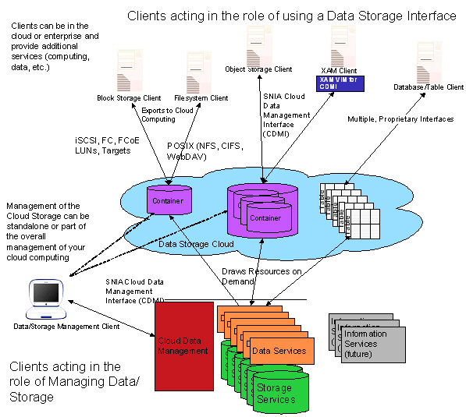
Overview CDMI
RESTful API for Cloud Data management
developed by SNIA
main concepts
  object storage
  support for legacy storage
  containers for grouping
  metadata
  simple management
Notes:
Storage Networking Industry Association

Slide 4
SNIA Cloud Plugfest
purpose is for vendors to to bring their implementations of CDMI and OCCI to test, identify, and fix bugs in a collaborative setting
organised by Storage Networking Industry Association
  1st plugfest April 2011 at SNIA Technology Center
  2nd plugfest July 2011 at SNIA Technology Center
  3rd plugfest will be Sep. 19 – Sep 22. 2011 in Santa Clara
  4th plugfest will be spring 2012 in Europe
remote participation encouraged
implementations and test instances will be collected in a wiki
  http://plugfest.sniacloud.com/wiki/index.php

Slide 5
Status OCCI Implementations
OCCI 1.1 Client / Server frameworks
  pyocci – Python module, part of Service Sharing Facility developed by
  Platform Computing
  OCCI for OpenNebula – Ruby framework,
  OpenNebula Ecosystem project
  occi-py – Python Framework,
  developed by OGF (Ralf Nyren)
OCCI Client libraries
  R2AD-Cloud-Client – JavaFX + Android implementation
  developed by R2AD
  jClouds integration – soon to be released by SLA@SOI EU project
OCCI Verification Suite
  developed by OGF OCCI WG to verify standard conformity
more implementations and information:
  http://occi-wg.org/community/implementations/

Slide 6

OCCI / CDMI usage
OCCI / CDMI Client
OVF
Template
Storage
OS
Resource
Network
Compute
OCCI Server
CDMI Server

Slide 7
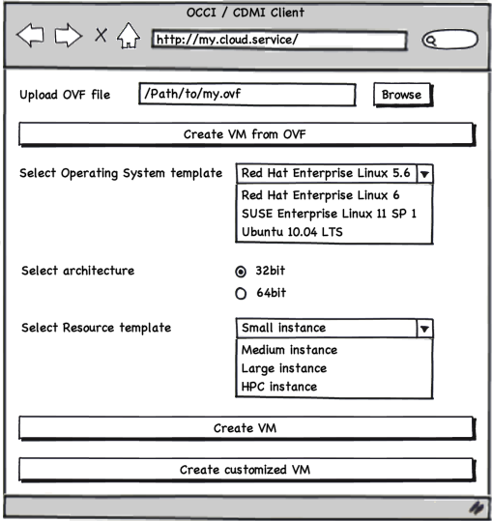

Slide 8
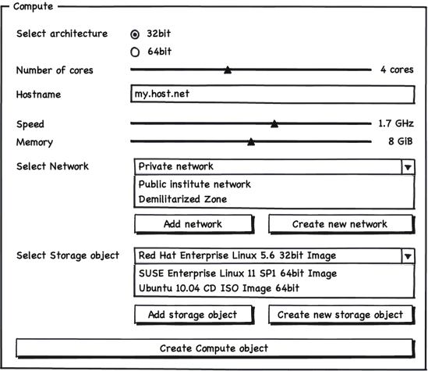

Slide 9
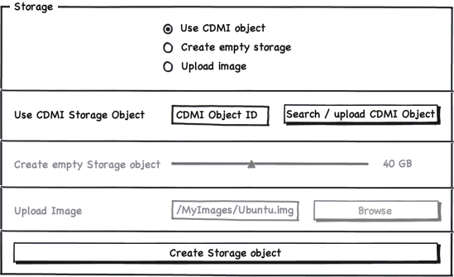

Slide 10
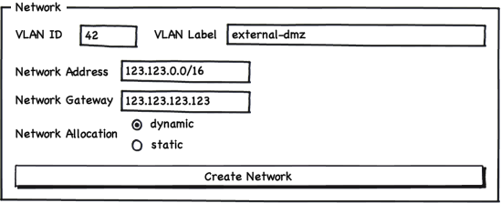

Slide 11
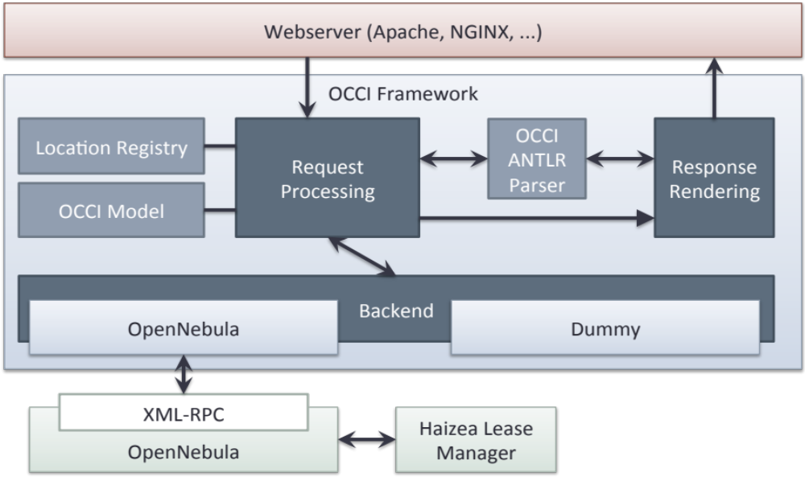
OCCI for OpenNebula

Slide 12
OCCI compute object GET
X-OCCI-Attribute: occi.compute.cores="1“
X-OCCI-Attribute: occi.core.summary="A short summary“
X-OCCI-Attribute: occi.core.title="My VM“
X-OCCI-Attribute: opennebula.vm.web_vnc=
http://localhost:5900/vnc_auto.html?host=localhost&port=5900
X-OCCI-Attribute: occi.core.id=
"38381d16-b001-11e0-8d67-00163e211160“
X-OCCI-Attribute: occi.compute.memory="4096“
X-OCCI-Attribute: occi.compute.state=“active“
X-OCCI-Attribute: occi.compute.architecture="x86"
Link: </storage/...>;...
Link: </network/...>;...
Link: </compute/...?action=restart>;...
Link: </compute/...?action=start>;...
Link: </compute/...?action=stop>;...
Link: </compute...?action=suspend>;...
Category: compute; ...
Category: vnc; ...
VNC Mixin

Slide 14
Status CDMI Implementations
SNIA CDMI Reference Implementation
  reference implementation & installation with OCCI / CDMI support
  developed by SNIA
NetApp CDMI Server
  developed as closed source by NetApp, but testing instance available to Plugfest participants
CDMI-Proxy
  CDMI proxy server for public cloud backends e.g. AWS, Azure
  developed as part of VENUS-C EU project under BSD license
CDMI client libraries
  Python – developed by VENUS-C, BSD license
  Java – developed by VENUS-C, BSD license
  Ruby (under dev.) – developed by OpenNebula, Apache 2.0 license

Slide 15
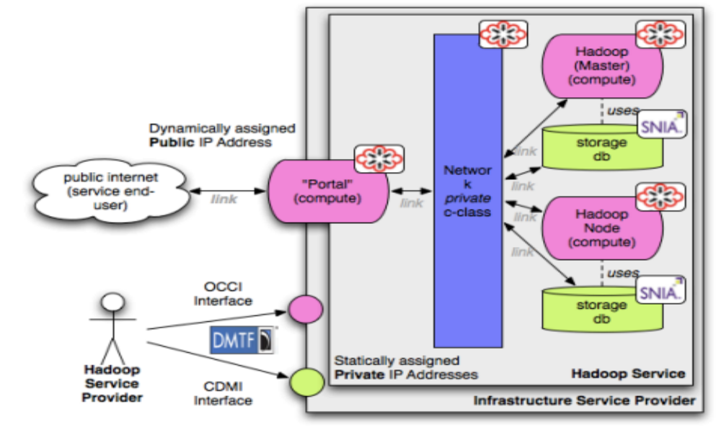
OCCI / CDMI Integration Scenario Hadoop

Slide 16
Outlook
several active OCCI and CDMI implementations
  progressing well into production ready solutions
integration of OCCI and CDMI works well
OVF integration under active development
SNIA Cloud Plugfest important for testing interoperability
next steps:
  advance standards using exerpience from implementations
  write implementation experience guides
  develop combined OCCI / CDMI / OVF verification suite
  stress/scaling testing
  interoperability testing

Slide 17
More information
OCCI WG website: http://www.occi-wg.org
SNIA CDMI website: http://www.sniacloud.com/
OCCI specification: http://www.ogf.org/gf/docs/
CDMI specification: http://cdmi.sniacloud.com/
Cloud Standards Wiki
  http://cloud-standards.org/wiki/index.php
OCCI Mailinglist
  http://www.ogf.org/mailman/listinfo/occi-wg
Cloud-Demo Google Group
  http://groups.google.com/group/cloud-demo
Open Standards, An Open Cloud – DMTF APTS mtg. 2011
by Andy Edmonds, Thijs Metsch, Eugene Luster

Slide 18
Thank you for your attention!

