Slide 1
Mapping OGF’s OCCI to DMTF’s OVF
Gary Mazzaferro Managing Partner AlloyCloud, Inc

Slide 2
Mapping OGF’s OCCI to DMTF’s OVF Agenda
Status
Overview OVF
Overview OCCI
Differences
Commonalities
Reconciled Aspects
Unreconciled Issues
Mappings

Slide 3
Mapping OGF’s OCCI to DMTF’s OVF Status
Based On Work from June 2009
Preliminary Analysis Complete
Mapping of Major Sections Complete
Unreconsiled Aspects 90% Complete
C++ Code Started April, 2011
Approach Discussion Needed for Unreconsiled Topics

Slide 4
Mapping OGF’s OCCI to DMTF’s OVF OVF Overview
DMTF’s Packaging Standard for Virtual Machines
Document Centric Approach to Platform Independent VM Portability
OVF file is organized as a multi-section XML document
The document contains meta-data about VMs as well as Disk Images Required by VMs.
OVF Meta-Data Includes Virtual Disks, Networking, Compute Resource requirements (e.g., CPU, Memory), Licensing, Product Information, VM Startup Sequence
Configuration information about one or more virtual machines.
OVF MetaData Closely Aligned to DMTF CIM Model

Slide 5
Mapping OGF’s OCCI to DMTF’s OVF Overview DMTF CIM
Component Object Model
Object Model Represent Real World Component
Servers, CPU, Networks, Adapters, Storage, Software, Clusters, Credentials, Storage & Network Switches, Gateways
Model Described in UML
Associations Link Components Together
High Fidelity
Detail Intended for Configuring & Monitoring Systems
Good For Technical SLAs
Supports Profiles
SMASH (Systems Management Architecture for Server Hardware)
DASH (Desktop/mobile Architecture for System Hardware

Slide 6
Mapping OGF’s OCCI to DMTF’s OVF CIM UML example

Slide 7
Mapping OGF’s OCCI to DMTF’s OVF OCCI Overview
Restful API for Creating and Administering Cloud VMs Across Heterogeneous Providers
Procedural Approach to Platform Independent VM Portability
Strategic API Focusing on Features (no fluff)
Employs Object Model Represent Real World Components (Cloud Resources)
CPU, Networks, Adapters, Storage
Resources are Associate with “Links”
Object Model May be Extended ‘On The Fly’
The Object Model contains meta-data about VMs
Provides a Discovery Mechanism & Description Scheme for Cloud Provider Resources using Categories
Categories act as Templates for Resources.

Slide 8
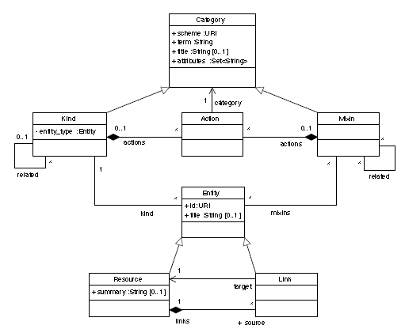
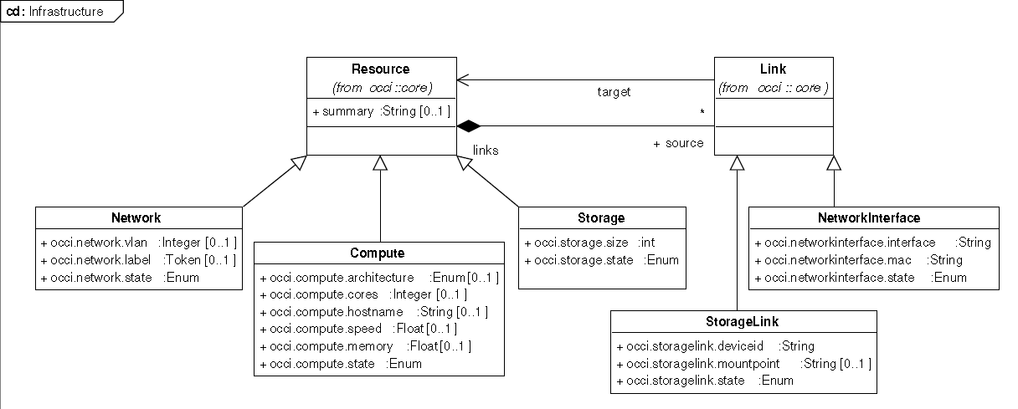
Mapping OGF’s OCCI to DMTF’s OVF OCCI UML example

Slide 9
Mapping OGF’s OCCI to DMTF’s OVF OCCI OVF Comparison
Document Centric
Robust Component Model (Attributes)
All VM Critical Components Modeled in XML
No Separation Of Category & Resource
Transfer in Single HTTP API Operation
All Configuration Modeled in Document
Components Associated in Document Hierarchy
Document Can Contain Multiple VM configurations
Procedure/API Centric
Simple Component Model (Attributes)
Critical VM Components Missing from OCCI Model
Full Separation of Category Resource
Demands Multiple HTTP Operations
No Document Model for Persisting VM Config.
Components Associated Through OCCI Links
Multiple VM Configurations Supported w/ Collections

Slide 10
Mapping OGF’s OCCI to DMTF’s OVF OCCI OVF Commonalities
Similar Component Model
VMs Constructed From Individual Components ie compute, storage, networking
Comparable Model Constructs for Multiple VMs
Comparable Model Constructs for Templates
OCCI Attributes Functionally Similar

Slide 11
Mapping OGF’s OCCI to DMTF’s OVF OCCI OVF Document Section Reconciliations
OVF |  |  |  | OCCI Mapping
Section | Description | Element Location | Multiplicity | Element
DiskSection | Describes meta-information about all virtual disks in the package | Envelope | Zero or one | Storage Resource
NetworkSection | Describes logical networks used in the package | Envelope | Zero or one | Network Interface Resource
ResourceAllocationSection | Specifies reservations, limits, and shares on a given resource, such as memory or CPU for a virtual machine collection | VirtualSystemCollection | Zero or one | Implemented as Mixin
AnnotationSection | Specifies a free-form annotation on an entity | VirtualSystem VirtualSystemCollection | Zero or one | Implemented as Mixin
ProductSection | Specifies product-information for a package, such as product name and version, along with a set of properties that can be configured | VirtualSystem VirtualSystemCollection | Zero or more | Not Implemented
EulaSection | Specifies a license agreement for the software in the package | VirtualSystem VirtualSystemCollection | Zero or more | Implemented as Mixin
StartupSection | Specifies how a virtual machine collection is powered on | VirtualSystemCollection | Zero or one | Implemented as Mixin
DeploymentOptionSection | Specifies a discrete set of intended resource requirements | Envelope | Zero or one | Attributes & Mixin
OperatingSystemSection | Specifies the installed guest operating system of a virtual machine | VirtualSystem | Zero or one | Mixin
InstallSection | Specifies that the virtual machine needs to be initially booted to install and configure the software | VirtualSystem | Zero or one | Mixin

Slide 12
Mapping OGF’s OCCI to DMTF’s OVF OCCI OVF Document Section Reconciliations
OVF |  | OCCI
Type | Description | Type
uint8 | Unsigned 8-bit integer | Integer
sint8 | Signed 8-bit integer | Integer
uint16 | Unsigned 16-bit integer | Integer
sint16 | Signed 16-bit integer | Integer
uint32 | Unsigned 32-bit integer | Integer
sint32 | Signed 32-bit integer | Integer
uint64 | Unsigned 64-bit integer | Integer
sint64 | Signed 64-bit integer | Integer
string | String | String
boolean | Boolean | Boolean
real32 | IEEE 4-byte floating point | Float
real64 | IEEE 8-byte floating point | Float

Slide 13
Mapping OGF’s OCCI to DMTF’s OVF OCCI OVF Document Section Unreconciled Aspects
Conformance
Included OVF files
Semantics of File Transfer using OCCI
Import workflow – import, export, new, running, existing OVF VMs
OVF File Transfer Integrity Checking
Importing Image File Instances As OCCI Element
Option 1: Use CDMI (needs full CDMI client support)
Option 2: Mixin + Provider Specific Mapping
OVF Section References
Configuration Overrides / Specifics
Export Mapping
Back fitting OCCI to OVF
Attribute Integer Values

Slide 14
Mapping OGF’s OCCI to DMTF’s OVF Conclusion/Discussion
Comments

Slide 15
Mapping OGF’s OCCI to DMTF’s OVF Related Work
OGF Glue workgroup
https://forge.gridforum.org/sf/go/doc14639?nav=1

