Slide 1
NSI CS Protocol State Machines and Message Handler

Slide 2
NSA: uRA, Aggregator and uPA
uRA: Ultimate Requester Agent
AG: Aggregator
uPA: Ultimate Provider Agent
NRM: Network Resource Manager
NSA
uRA
NSA
AG
NSA
NSA
uPA
AG
NRM
uPA
NRM

Slide 3
State Machines and Message Handler
Behavior of NSI CS protocol is modeled as state machines and message handler
State Machines:
  RSM: Reservation State Machine
  PSM: Provision State Machine
  ASM: Activation State Machine
  LSM: Lifecycle State Machine
Aggregator:
  can talk to upstream and downstream NSAs
  Has RSM, PSM and LSM
uPA
  Can talk to upstream NSAs only
  Has RSM, PSM, ASM and LSM

Slide 4
Aggregator
NSI message
NSA
Message
Handler
Lifecycle
SM
Resv.
SM
Resv.
SM
Resv.
SM
Resv.
SM
Prov.
SM
Prov.
SM
Prov.
SM
Prov.
SM
NSI message

Slide 5
uPA
NSI message
NSA
Message
Handler
Resv.
SM
Resv.
SM
Resv.
SM
Resv.
SM
Prov.
SM
Prov.
SM
Prov.
SM
Prov.
SM
NRM
Act.
SM
Act.
SM
Act.
SM
Act.
SM
Resv.
DB

Slide 6
RSM: Reservation State Machine
Initial
>rsv.rq
>rsv.rq
Reserved
Modifying
<modify.cf
<modify.cf
>mdfychk.rq
>mdfychk.rq
>modify.rq
>modify.rq
*1:Modify Checking, Modify Checked, Modify Failed, Modify Timeout
and Reserved
<rsv.cf
<rsv.cf
Reserving
Modify
Checking
<mdfychk.cf
<mdfychk.cf
Modify
Checked
<rsv.fl
<rsv.fl
<mdfychk.fl
<mdfychk.fl
(modify_timeout)
<modifyTimeout.nt
Reserve
Failed
Modify
Failed
Modify
Timeout
Modify timeout transitions back to Reserved. (This transition will only happen in uPA)
Initial State
Reserved
<mdfycncl.cf
<mdfycncl.cf
Modify
Canceling
*1
>mdfycncl.rq
>mdfycncl.rq
Transitional States
NB: Requests* received in this state is queued and processed only when it transitions to a Stable State. *NB: Exceptions are term.rq and unexpected messages (e.g. illegal sequence)
Stable States
Final State
6

Slide 7
PSM : Provision State Machine
Provisioning
>prov.rq
>prov.rq
<prov.cf
<prov.cf
Removed
>prov.rq
>prov.rq
Initial
Scheduled
Provisioned
Created
>rel.rq
<rel.cf
>rel.rq
>rel.rq
<rel.cf
<rel.cf
Releasing
Initial State
Transitional States
NB: Requests* received in this state is queued and processed only when it transitions to a Stable State. *NB: Exceptions are term.rq and unexpected messages (e.g. illegal sequence)
Stable States
Final State

Slide 8
LSM : Lifecycle State Machine
Terminate
Terminating
Initial
<term.cf
<term.cf
>term.rq
>term.rq
Initial State
Transitional States
Stable States
Final State

Slide 9
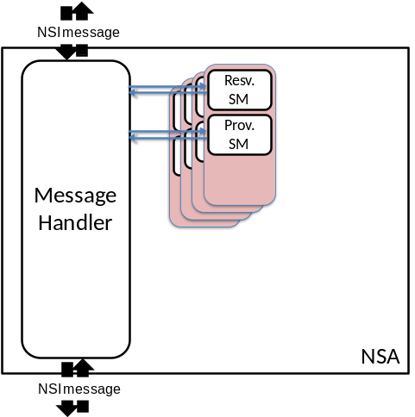
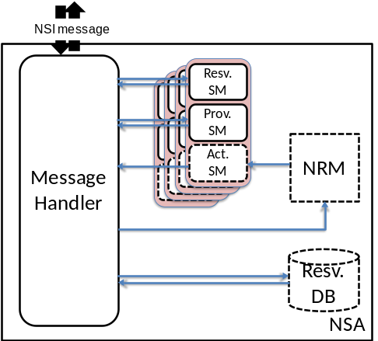
NSA: uRA, Aggregator and uPA
NSA
uRA
NSA
AG
NSA
NSA
uPA
AG
NRM
uPA
NRM

Slide 10
Modify
Modify operations modify reservation
Currently, following two changes are supported
  Change end time of a reservation
  Change bandwidth
Modify is a 2-phase operation
  1: check availability (ModifyCheck.rq)
    Note: resources are held
  2: Commit (Modify.rq) or Abort (ModifyCancel.rq)
When committed, the reservation is updated
  Reservation has a version number assigned by uRA, and the version number is updated when committed (uniformly increasing)

Slide 11
Provision and Release
Provision state machine is independent from the reservation state machine
Provision state:
  Data plane should be activated if the PSM is in “Provisioned” state AND start_time < current_time < end_time
  Data plane shall not be activated before the start_time
A connection can be repeatedly provisioned and released

Slide 12
Data plane activation
Data plane should be activated if the PSM is in “Provisioned” state AND start_time < current_time < end_time
Activation is done at the timing of following events (if the above condition is met), using the latest reservation information
  PSM transits to “Provisioned”
  At the start_time
  Reservation is updated (by commit of modify)
  Data plane is recovered from an error
Data plane activation/deactivation are notified by DataPlaneStateChange.nt notification messages.
Errors are notified by a generic error message

Slide 13
DataPlaneStateChage.nt (1)
PA and aggregator has DataPlaneStatus information
  (Boolean) Active: True if data plane is active. For an aggregator, this flag is true when data plane is activated in all participating children
  (Int) Version: For a uPA, current (latest) reservation version number. For an aggregator, the largest version number of the participating children. This field is valid when Active is true.
  (Boolean) VersionConsistent: Always true for uPA. For an aggregator, If version numbers of all children are the same, This flag is true. This field is valid when Active is true.
When a valid filed of DataPlaneStatus is changed, DataPlaneStatusChange.nt is sent up.
DataPlaneStatus
Active
Version
VersionConsistent

Slide 14
DataPlaneStateChage.nt(2)
An aggregator keeps an array of statuses of its children, ChildrenDataPlaneStatus[1..n]
Aggregator’s DataPlaneStatus is determined by the following rule
if all of ChildrenDataPlaneStatus[1..n].Active are true
then
{
DataPlaneStatus.Active = true
DataPlaneStatus.Version =
maximum_of(ChildrenDataPlaneStatus[1..n].Version)
If all ChildrenDataPlaneStatus[1..n].Version are the same, and all
of ChildrenDataPlaneStatus[1..n].VersionCosistent are true
then DataPlaneStatus.VersionConsistent = true
else DataPlaneStatus.VersionConsistent = false
}
ChildrenDataPlaneStatus
DataPlaneStatus
Active
Active
Active
Active
Ver.
Ver.
Ver.
Ver.
VC
VC
VC
VC
Child 1
Child 2
Child n

Slide 15
Notifications: Activation related
There are no activateComplete.nt nor deactivateComplete.nt
A general error message is used to notify following events. Those error are sent up the tree to uRA immediately
  activateFailed: Activation failed at the time when uPA should activate its data plane
  deactivateFailed: Deactivation failed at the time when uPA should deactivate its data plane
  dataplaneError: Data plane is deactivate when deactivation is not expected. The error is recoverable.
  forcedEnd: Something unrecoverable is happened in uPA/NRM

Slide 16
Requests which can fail
Operations which can functionally fail are:
  Reserve.rq
  ModifyCheck.rq
  Those requests fail when requested resources are not available.
Other operation cannot fail. However, they can timeout in MTL/MH, or can be denied because they are invalid requests.
  If a SM is at a state in which the request cannot be received, the request is denied.
    *.na (not applicable) message is returned.

Slide 17
Message Handler (MH) and
Message Transport Layer (MTL)
NSI stack
MH is a part of NSI stack, and uses MTL to send/receive messages
MH is primarily responsible for keeping track of messaging state, e.g.
  Who was the message sent to
  Was the message received (i.e. ack’ed or MTL timeout)
  Who has not replied to the message (e.g. *.cf, *.fl, etc)
Message Handler
Message Transport Layer
MTL is primarily responsible for sending and receiving messages, and notifying MH if the message was received, or if a (MTL) timeout occurs
MTL interface (to MH) has 2 simple operations:
  Send: blocks until ack is returned by destination MTL, or timeout happens. Timeout value is implementation dependent. NB: The MTL may be implemented to retry sending messages, but this is opaque to the MH
  Receive: a thread in MH is invoked when a message is received

Slide 18
Message ack, reply and timeouts
: MTL timeout may happen
Requester
Provider
: MH timeout may happen
MH
MTL
MTL
MH
Ack is sent by MTL for each message
  If ack is not returned in a certain period of time, MTL timeout occurs
Reply is sent by MH (via MTL) and is either confirm, fail or not_applicable
  MH can timeout if expected reply is not received from a child
request
message
request
thread
blocked
ack
return
reply
message
thread
blocked
reply
ack
return
notification
message
thread
blocked
Notification
ack
return

Slide 19
Timeouts
Message transport layer (MTL) timeout
  Underlying MTL (http/tcp) initiates a MTL timeout
  Happens when an ack is not returned for a message.
Message Handler (MH) timeout
  MH can timeout if a reply message is not returned in a certain period of time
MH notifies both MTL and MH timeouts to the parent RA
When a MTL/MH timeout is notified, uRA can either retry or terminate the connection.
  Retry is requested by NSI_messageRetry.rq, which has the original request message's id (correlation id) as a parameter
  MH keeps not-yet-replied requests in a table, so that it can re-send the request.

Slide 20
Tables an aggregator MH maintains for each reservation (connection)
FAIL_FLAG(cor)
CON
A
Z
Parameters
COR
FAIL_FLAG
CL(con)
RCV_LIST(cor)
NSA1
C_CON1
A1
Z1
Parameters1
RSM1
PSM1
ASM1
LSM1
C_COR1
STATUS1
NSA2
C_CON2
A2
Z2
Parameters2
RSM2
PSM2
ASM2
LSM2
C_COR2
STATUS2
NSAn
C_CONn
An
Zn
Parametersn
RSMn
PSMn
ASMn
LSMn
C_CORn
STATUSn
Expected states of children
including version info.
(for non-recursive queries)
Flags to indicate:
A reply has been received
A MTL timeout has occurred
A MH timeout has occurred
Generated for each reservation (connection)
Generated for
each request

Slide 21
modifyCancel after timeout
After modifying operations, if a NSA is already in RESERVED state, it can receive NSI_modifyCancel.rq and reply NSI_modifyCancel.cf, but the modification is not rolled back. The system may be in an inconsistent state (different versions across the system) after those operations.

Slide 22
Notifications: modify timeout and MTL failure
NSI_modifyTimeout.nt
NSI_genericEvent.nt
  Message delivery failure will be notified by this message (to be defined)
When a MTL/MH timeout is notified, uRA can either retry or terminate the connection.
  Retry is requested by NSI_messageRetry.rq, which has the original request message's id (correlation id) as a parameter

Slide 23
Termination and LSM
A connection lifecycle is terminated when NSI_terminate.rq is received.
LSM (Lifecycle State Machine) handles the terminate request.
  Terminate request will delete the RSM, PSM and ASM, but the LSM should be there to send/receive terminate request and confirm messages
  uPA may delete RSM, PSM and ASM when it isseues fcd_end, but LSM cannot be deleted.

