Slide 1
Automated GOLE + NSI demos
Supercomputing 2012
Salt Lake City
Jerry Sobieski
Nov 2012

Slide 2

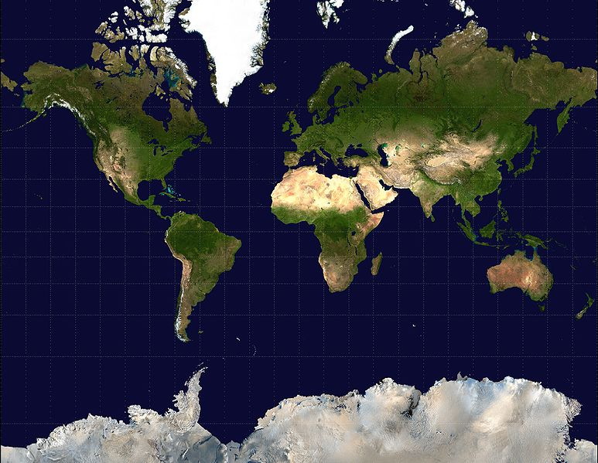
Automated GOLE Fabric
Nordunet
KRLight
CANARIE
Pionier
ACE
PSNC
GLORIAD
StarLight
NetherLight
GEANT
US LHCnet
WIX
CzechLight
KDDI Labs
JGN-X
UvA
Cern
ESnet
MAX
AIST
The GLIF Automated GOLE global fabric
  The GLIF Automated GOLE Pilot was initiated in 2010 to provide a global fabric of Open Lightpath Exchanges for the express purpose of maturing the dynamic provisioning software, demonstrating the value of GOLEs to emerging network service models, and to develop a set of BCP for these services.

Slide 3


Automated GOLE + NSI
Joint NSI v1+v2 Beta Test Fabric Nov 2012
Ethernet Transport Service
KRLight
DynamicKL
DAE
A
GLORIAD
OpenNSA
Network
MAX
OpenNSA
WDC
NORDUnet
OpenNSA
Network
UvA
OpenNSA
AMS
KRLight
A
A
A
A
A
KDDI-Labs
G-LAMBDA-K
Fujimino
WIX
OpenNSA
WDC
StarLight
OpenNSA
CHI
NetherLight
OpenDRAC
AMS
CzechLight
OpenDRAC
PRA
JGN-X
CESNET
JGN-X
G-LAMBDA-K
TOK
A
ACE
Pionier
AutoBAHN
POZ
A
GEANT
AIST
G-LAMBDA-A
Tsukuba
SC12
Salt Lake City
ESnet
OSCARS
US-LHCnet
OSCARS
GEANT
BoD
PSNC
AutoBAHN
POZ
NSIv1 Networks and Exchange Points
NSIv2 Networks and Exchange Points
NSI peerings (SDPs) unless otherwise indicated these are vlans 1780-1783
Planned/peerings (SDPs)

Slide 4
NSI + Automated GOLE Message
Global Consensus, Global Ubiquity!
  NSI is a consensus protocol for global, inter-domain provisioning of connection oriented services
  NSI can be deployed everywhere, we can build performance guaranteed connections anywhere…
Open Lightpath Exchanges !
  GOLEs are the emerging consensus architecture for global multi-service peering and interconnection.
Roadmap:
  NSI v1 proved viability and interoperability in 2011
  NSI v2 in 2012 completes a production capable set of basic services
  NSI v2 (beta) in development now
  NSI Production services slated for Spring 2013
  NSI v3 will begin specification in Spring 2013… available 2014

