Slide 1
NSI Topology v2.0
Version 1.1
John MacAuley, SURFnet
Derived from discussions with Jerry @ SC 2013

Slide 2
Terminology
Network
  A group of network resources managed by a single network provider and a single NSA.
  A network exposes a set of defined service types representing the services offered to a user by the network.
Intra-Network Topology
  Refers to the topology of resources within a network, and the services offered by that network.
Inter-Network Topology
  Refers to the topology of interconnected Networks and the common services offered across these interconnected Networks.
  Inter-Network Topology is concerned with describing the way in which Networks are statically interconnected by treating each Network as an aggregated set of Network capabilities and Edge Points.
Service
  A service is a “connection” between two points in a Network with certain predefined and dynamically specified characteristics that will deliver a payload from Network ingress to Network egress unmodified.
Service Type
  A predefined type of service offered by a network and specified by a Service Definition.

Slide 3
Terminology
Service Definition
  A document that describes the predefined characteristics and requestable elements associated with a service being offered by a Network.
Service Termination Point (STP)
  An STP names a topological location that is the ingress/egress point of a Network and is defined by a single Service Type.
  An STP can be fully specified representing a single termination point, or under specified representing a set or bundle of STP.
Service Domain
  A group of STP within a Network described by a single Service Type and can be fully interconnected without restriction.
  Service Domain is equivalent to the NSI Transfer Function as defined in the NSI Reference Architecture.
Service Demarcation Point (SDP)
  SDP are formed when a pair STPs of matching capabilities are considered adjacent (and connectable) between two Service Domains.
Service Region
  The set of interconnected Service Domains of the same Service Type. (i.e. Inter-Network Topology for that service type).

Slide 4
Terminology
Adaptation (Interworking)
  By definition, Service Domains of different Service Types cannot be directly connected due to the differing Service Definitions, however, an Adaptation can be defined that permits interconnection of STP from two different Service Domains using the concepts of encapsulation and adaptation.
  An Adaptation defines the (de)encapsulation or (de)adaptation of one service type into another service type if the Network is capable of offering the service.
  An Adaptation has directionality (adaptation and de-adaptation).
  Unidirectional and bidirectional Adaptations are supported, with bidirectional Adaptations containing a symmetric pair of adaptation and de-adaptation functions.
  An Adaptation can also be defined between STP of the same service type in the case where encapsulation/adaptation of the input service type results in the same output service type.
  An Adaptation has an associated Service Definition describing the Service Adaptation, parameters of the service, attributes of the service, and specifically any restrictions/limitations.

Slide 5
Service Domain
In a Service Domain any STP can be connected to any other STP.
A Service Domain has an associated Service Definition (SD) describing the service being offered.
Service Domains are grouped into Network topologies that can be advertised by at most one NSA.
An NSA can advertise multiple Network topologies.
STP 1-A-2
Service Domain 1
SD A
STP 1-A-1
STP 1-A-3
Service Domain 2
SD B
STP 2-C-3
STP 2-C-1
STP 2-C-2
Service Domain 3
SD C
STP 3-C-1
STP 3-C-3
Network 1
STP 3-C-2
NSA 1

Slide 6
Service Domain
Service Domain 1
Service Domains can be nested to model internal structure.
Externally visible STP are used for inter-domain interconnection to peer networks.
Internal STP are used to connect the internal Service subdomain as well as to the Domain’s external STP points.
An external path finder could issue a request to connect STP-1-A-1 to STP-1-C-1 and delegate internal path finding to the uPA, or if the path finder would like to provide additional guidance, it could specify a more detailed path such as (STP-1-A-1, STP-1-A-3), (STP-1-B-3, STP-1-B-2), and (STP-1-C-3, STP-1-C-1).
STP-1-B-3
STP-1-A-3
SD-1B
E-SDP
Service Domain
1A
STP-1-B-1
STP-1-B-2
E-SDP
STP-1-A-2
I-SDP
STP-1-C-3
STP-1-A-1
SD-1C
E-SDP
STP-1-C-2
STP-1-C-1
Key
Internal STP
External STP
Internal SDP
External SDP

Slide 7
NSI Transfer Function
In this new model the Transfer Function is not required since similar outcomes can be achieved through the definition of separate Service Domains.
Remember a Service Domain has the requirement for single Service Type and full interconnectivity between member STP.
Service Domain 1
TF1
Service Domain 2
TF2
Network
Network

Slide 8
Adaptation
Service Domains contain a set of STP of the same Service Type that are capable of being interconnected.
Adaptations are used to connect STP from two Service Domains within the same Network, essentially allowing a path finder to determine if it is possible to “enter” an STP in one Service Domain and “exit” an STP on a different Service Domain.
Adaptation STP are added to each Service Domain to anchor the transitional SDP associated with the Adaptation. This transitional SDP is not used in connections, and is only present to enable path finding between the domains.
Adaptations are defined with their own Service Definition, describing the capabilities of the adaptation, and the service specific parameters needed to make the reservation requests across the Adaptation.
A request to NSA 1 going from STP 1-A-2 to STP 2-C-2 can be made in a SINGLE request, however, the request parameters must specify the Service Type of the Adaptation. These parameters will contain values required by each component STP, as well as adaptation specific parameters. For example:
  resv.req (
  serviceType=“B”,
  sourceStp=“STP 1-A-2”,
  sourceParams={Ethernet parameters}, destStp=“STP 2-C-2”,
  destParams={SDH parameters},
  adaptParms={Adaptation specific params}
  );
STP 1-A-2
Service Domain 1
SD A
STP 1-A-1
STP 1-A-3
Adaptation
SD B
Service Domain 2
SD C
STP 2-C-1
STP 2-C-3
Network 1
STP 2-C-2
NSA 1

Slide 9
Adaptation within Service Domains
Adaptations can be defined between STP of the same type, resulting in an adaptation occurring between two STP within the same Service Domain.
A service request of this type would require specification of the Service Definition for the adaptation, and not the Service Definition associated with the Service Domain.
A request to NSA 1 going from STP 1-A-1 to STP 1-A-3 can be performed using the Service Type of the Adaptation allowing for manipulation of the ingress service. These parameters will contain values required by each component STP, as well as adaptation specific parameters. For example, we define SD B to allow the encapsulation of the ingress service PDU with the addition of a VLAN identifier:
  resv.req (
  serviceType=“B”,
  sourceStp=“STP 1-A-1”,
  destStp=“STP 1-A-3”,
  EthernetParams={Ethernet parameters},
  adaptParms={Push vlan=1790}
  );
The path finder can then “pop” the added VLAN identifier later in the path using the reverse Adaptation.
STP 1-A-2
Service Domain 1
SD A
STP 1-A-1
STP 1-A-3
Adaptation
SD B
Service Domain 2
SD C
STP 2-C-1
STP 2-C-3
Network 1
STP 2-C-2
NSA 1

Slide 10
Adaptation in action
In this example we have an EPL service offered in Service Domain 1 defined by Service Description A, and an 802.1Q Trunk service in Service Domain 2 defined by Service Description C.
The EPL service offered in Service Domain 1 could be implemented using a number of technologies, however, from an end user perspective this is not important as they are interested in the service being offered, and not the technology behind the service.
For adaptation between Service Domain 1 (Service Definition A) and Service Domain 2 (Service Definition C) in Network 1 we require a transform from the EPL service to the 802.1Q Trunk compliant service. For this example, we define an Adaptation (Service Definition B) that interconnects STPs in Service Domain 1 to STPs in Service Domain 2 through encapsulation of the original EPL service Ethernet frames using 802.1AH. The 802.1AH frame is compatible with Service Domain 2, using the S-TAG from the 802.1AH frame as the switching VID. Where this encapsulation occurs in the network is irrelevant from a path finder perspective, and is left up to the supporting NSA to worry about the details.
Similarly, in Network 2 we must reverse the encapsulation performed in Network 1 to get back the original service type to deliver to the end user. In this case the paired Adaptation (Service Definition B) in Network 2 is used to remove the 802.1AH header allowing an STP in Service Domain 3 (Service Definition C) to be connected to an STP in Service Domain 4 (Service Definition A) getting us back to the original Service Type.
STP 1-A-2
STP 4-A-2
Service Domain 1
SD A - EPL
Service Domain 4
SD A - EPL
STP 1-A-1
STP 1-A-3
STP 4-A-1
STP 4-A-3
Adaptation
SD B
Adaptation
SD B
Service Domain 2
SD C –
802.1Q
STP 2-C-3
Service Domain 3
SD C –
802.1Q
STP 3-C-1
STP 2-C-1
STP 3-C-3
Network 1
STP 2-C-2
Network 2
STP 3-C-2

Slide 11
Terminology Alignment
Framework Terminology | New Terminology | Notes
Inter-Network Topology |  | The full interconnectivity of all defined networks.
 | Service Region | A Service Region is a single Service Type subset of the Inter-Network Topology.
Network Service Agent (NSA) | Network Service Agent (NSA)
Network | Network | A network object collects a set of Service Domains (Transfer Functions), STP, SDP, and Adaptations.
Transfer Function | Service Domain | A Service Region has equivalent functionality and behaviors to the original NSI Transfer Function minus any implied adaptation.
Service Termination Point (STP) | Service Termination Point (STP)
 | Adaptation | Provides the ability to adapt services using STP of different Service Domains, or two STP of the same Service Domain.
Service Demarcation Point (SDP) | Service Demarcation Point (SDP)
Service Type | Service Type
Service Definition | Service Definition

Slide 12
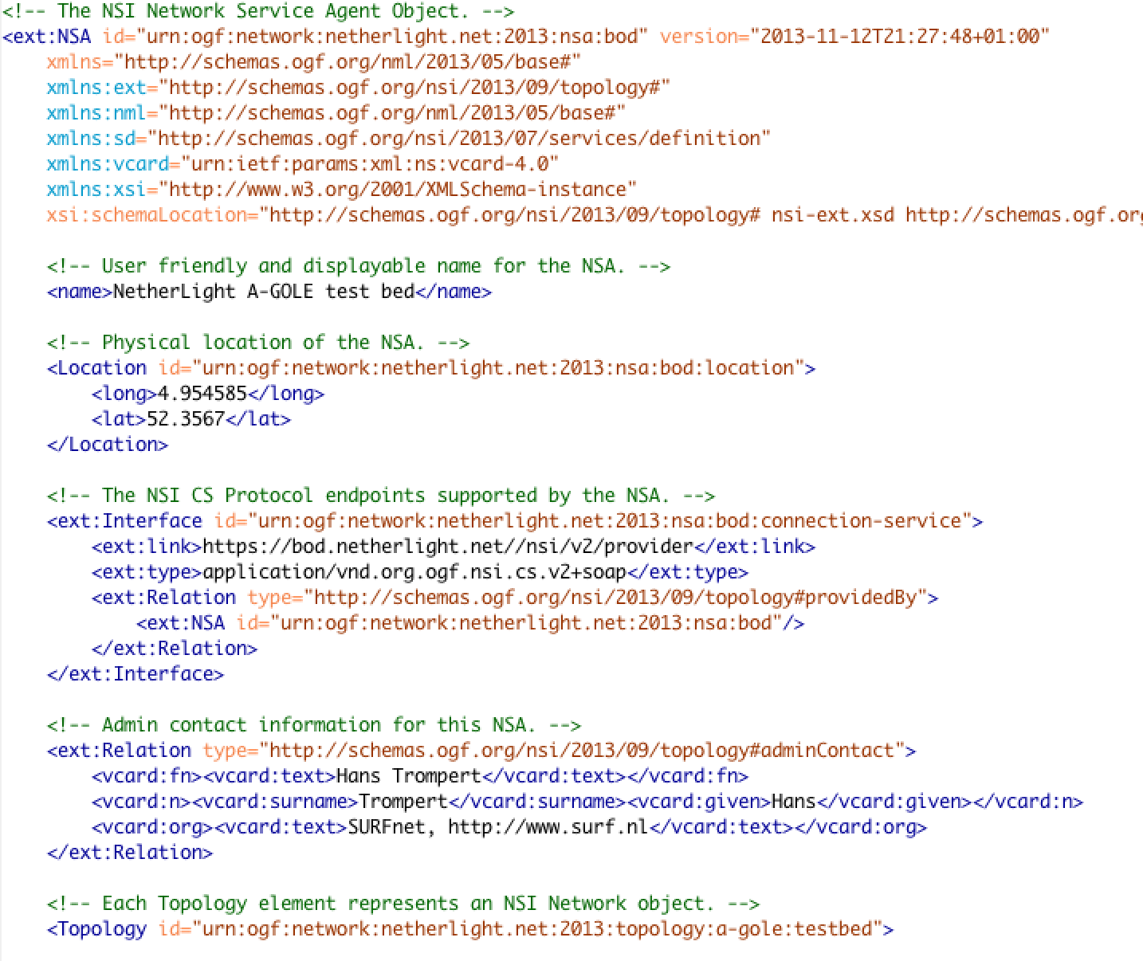
NSI Network Service Agent
The NSA element is the root container holding all NSI topology components relating to a single NSA. It identifies the NSA managing the topology, and the version of the topology document.
NSA identifier associated with this topology, and the version of the document.
Replaced by NSA
Description Document
User friendly name of the NSA used for display.
Geographical coordinates of the NSA.
Versions of the NSI CS protocol supported by this NSA.
Administrative contact information for this NSA.
Beginning of the detailed network topology element. One topology element is specified per NSI Network with the Topology “id” mapping to the NSI Network Id.

Slide 13
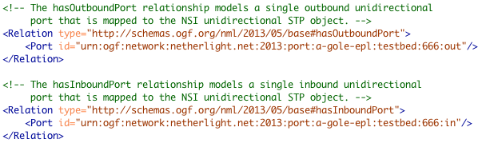
NSI Service Termination Points
The Port element maps to a unidirectional STP.
From these two port definitions we would generate the following unidirectional STP identifiers:
  urn:ogf:network:netherlight.net:2013:port:a-gole-epl:testbed:666:out
  urn:ogf:network:netherlight.net:2013:port:a-gole-epl:testbed:666:in

Slide 14
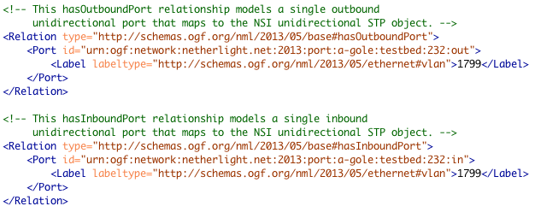
Unidirectional STP from Port and Label
The Port element maps to a unidirectional STP.
The Label elements contains a single value that is used to fully qualify an STP. From these two port definitions we would generate the following STP identifiers:
  urn:ogf:network:netherlight.net:2013:port:a-gole:testbed:232:out?vlan=1799
  urn:ogf:network:netherlight.net:2013:port:a-gole:testbed:232:in?vlan=1799

Slide 15
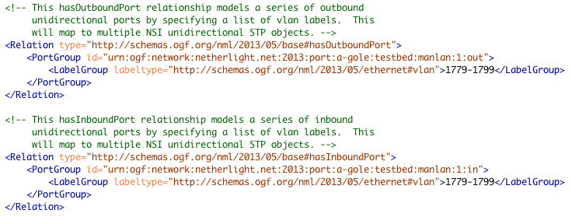
Unidirectional STP from PortGroup and LabelGroup
The PortGroup element is a summary mechanism used to specify
a mapping to one or more unidirectional STP.
The LabelGroup elements can contain a range of values that are used to generate fully qualify STP or underspecified STP. From these two port definitions we would generate the following underspecified STP identifiers:
  urn:ogf:network:netherlight.net:2013:port:a-gole:testbed:232:out?vlan=1779-1799
  urn:ogf:network:netherlight.net:2013:port:a-gole:testbed:232:in?vlan=1779-1799
For fully qualified STP we would get 20 of each inbound and outbound built as on the previous slide.

Slide 16
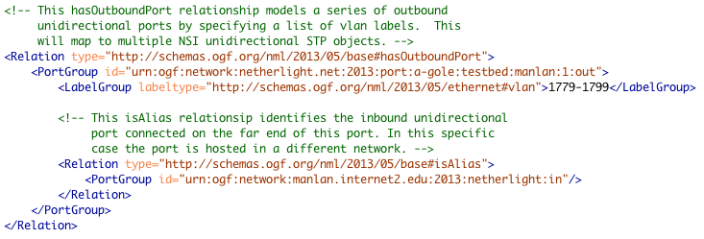
NSI Service Demarcation Points
The Port and PortGroup elements may contain an isAlias relationship indicating connectivity to another Port or PortGroup. We use this isAlias relationship to create an SDP between the adjacent STP generated from the Port or PortGroup elements.

Slide 17
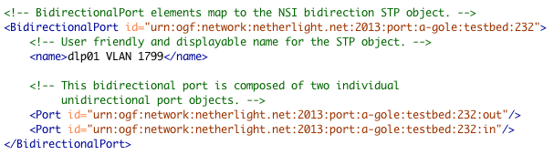
Bidirectional STP
The BidirectionalPort element groups a pair of inbound and outbound Port or PortGroup elements to create a bidirectional STP.
The BidirectionalPort id is used as the root for the bidirectional STP identifier, but we must also navigate to the unidirectional Port/PortGroup definitions to determine any labels being used. The following bidirectional STP identifier would be created based on the unidirectional Port specification:
  urn:ogf:network:netherlight.net:2013:port:a-gole:testbed:232?vlan=1799

Slide 18
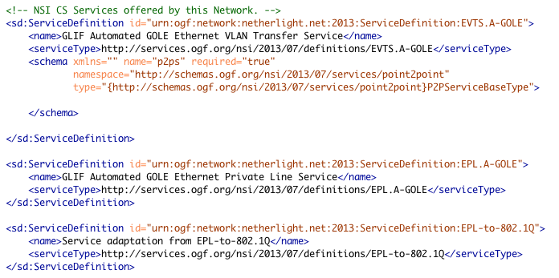
NSI CS Services
…
…
Full service definition can
be included.
Reference to Service
Definition type
Adaptation Service Definition type

Slide 19
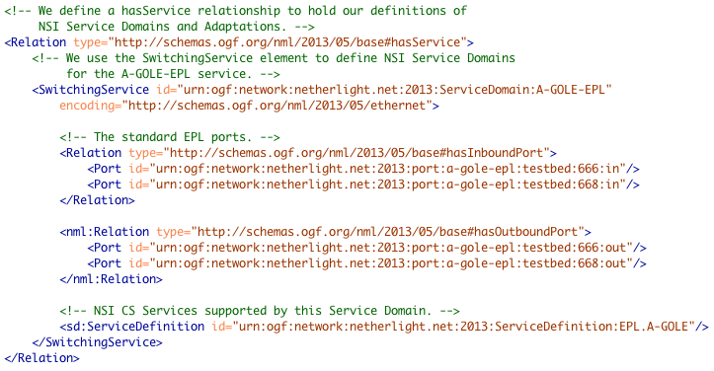
NSI Service Domain
The SwitchingService element is used to model NSI Service Domains. A single SwitchingService declaration can expand into many NSI Service Domains depending if label swapping is supported. Inbound and outbound Port/PortGroup elements are specified as members.
The ServiceDefinition element identifies the services supported in this Service Domain.

Slide 20
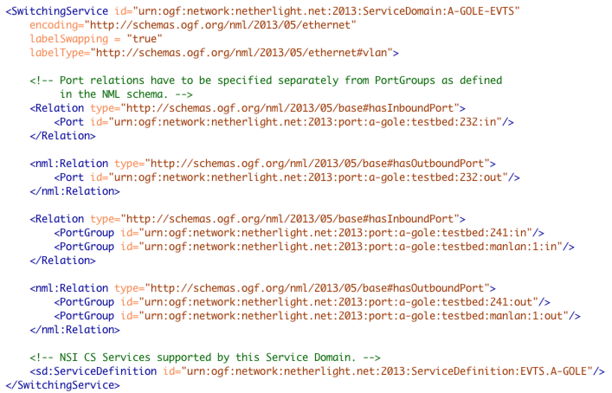
Label Swapping
The SwitchingService supports the concept of label swapping. If the labelSwapping attribute is set to true then any port within the SwitchingService can be connected to any other port independent of label. If set to false, then only ports with equivalent labels can be interconnected.
labelSwapping set to “true” indicates that ports can be connected with different label values.
labelType indicates the label that could be switched.
Port elements can be members of
SwitchingService.
PortGroup elements can also be members of SwitchingService.

Slide 21
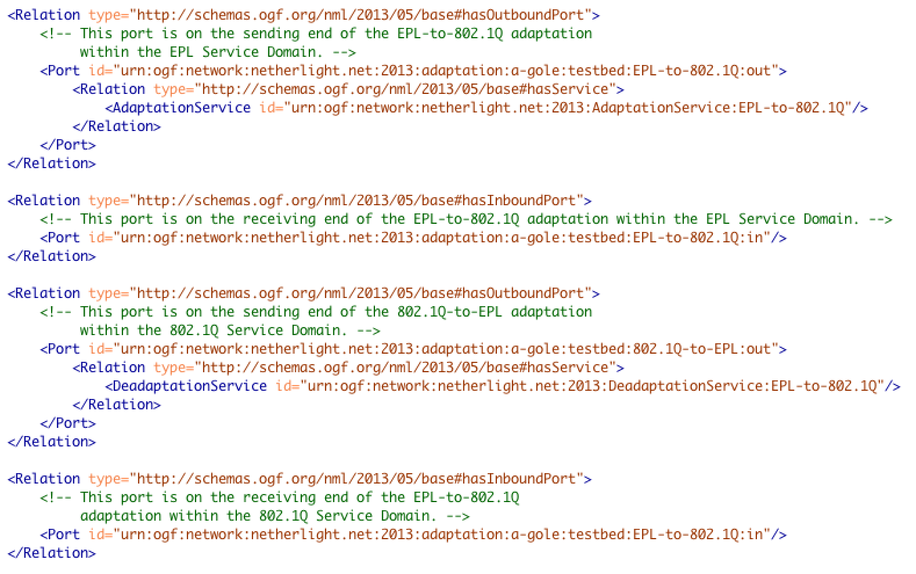
Adaptation Port Definition
Adaptation is port based in NML, so to model an adaptation between NSI Service Domains, we must create special STP for referencing within the Adaptation. In our specific case, we create four unidirectional ports per adaptation. The outbound port from the source Service Domain #1 references the AdaptationService, and the AdaptationService references the inbound port of the destination Service Domain #2. Similarly, for deadaptation the outbound port in Service Domain #2 references the DeadaptationService, and the DeadaptationService references the inbound port on Service Domain #1.
Outbound Port elements reference the (De)AdaptationService.
Need to fix based on feedback

Slide 22
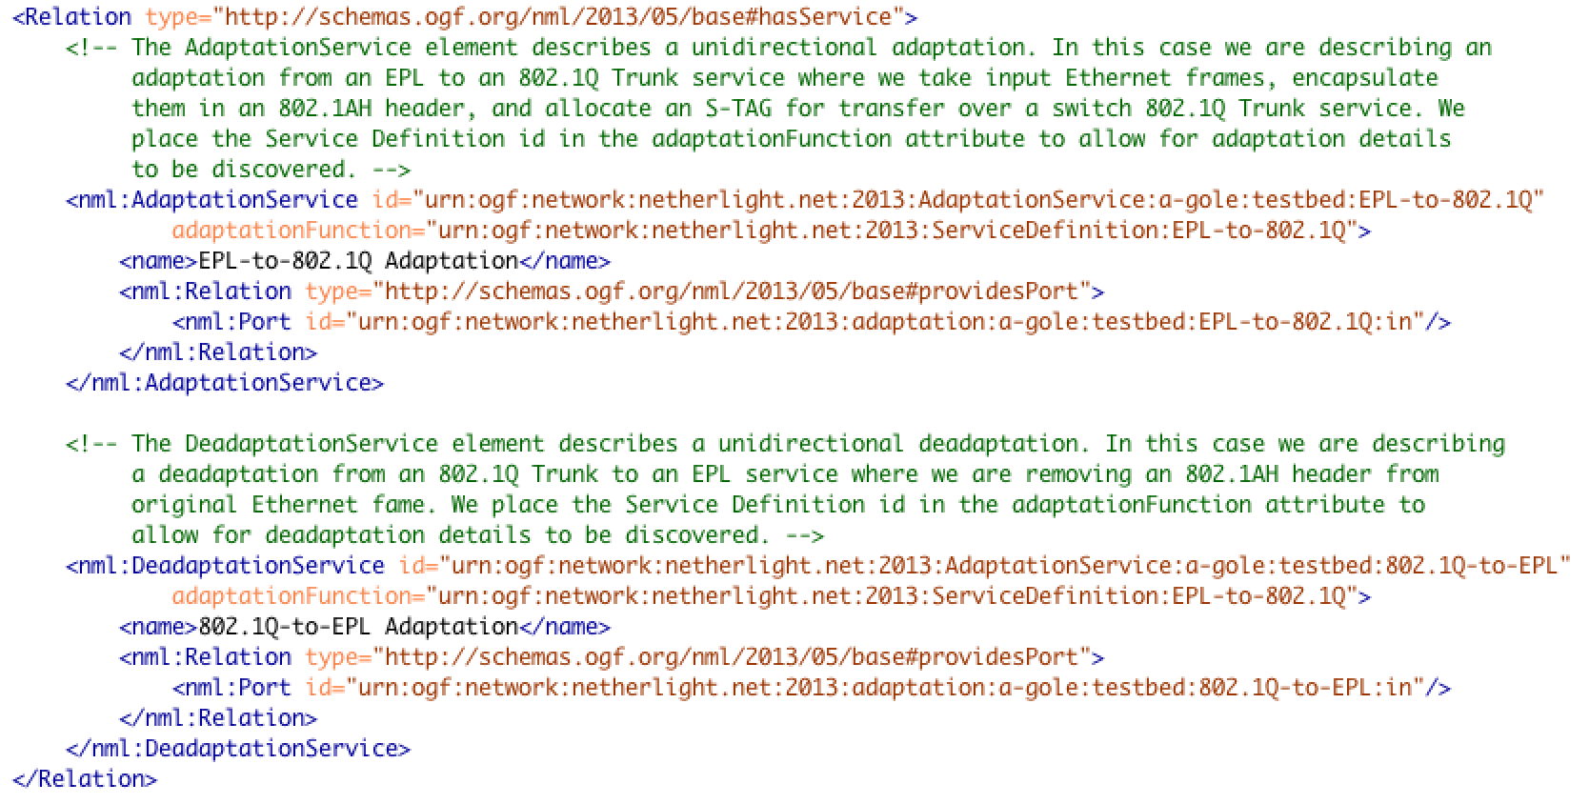
Adaptation Service Definition
Adaptation Id is referenced by source port.
Service Definition for adaptation is referenced by Id.
Target port of adaptation.
Target port of deadaptation.
Need to fix based on feedback
Service Definition for deadaptation must be same reference Id as adaptation.

