Slide 1
NSI Reservation request message sequence
This presentation proposes a messaging sequence to support path reservation over multiple networks.
The first use case is for a single NSI interface communicating with a single instance of NSA interfacing to a single network.
The second use case is for a chain model requests. Here the path is built in an RSVP like way. At each network a local connection is reserved to connect to the next network in the path/e2econnection. Once the local reservation is begun, the reservation request is then forwarded to the next network down stream.
A third use case describes a ‘tree’ model request mechanism. Here the local connections that make up the e2e connection can be requested in any sequence.
Issues –
1. In tree model, how does each domain know which networks have already been requested? There is a risk of a request being forwarded multiple times causing a request forwarding loop. This may require a full reservation state to be kept at each node – this does not scale well.
2. The tree mode of operation makes it necessary for the originating NSA to keep reservation, instantiation and cancellation success/fail state for each NSA. This is different to the RSVP like approach where only the net connection state is kept.

Slide 2
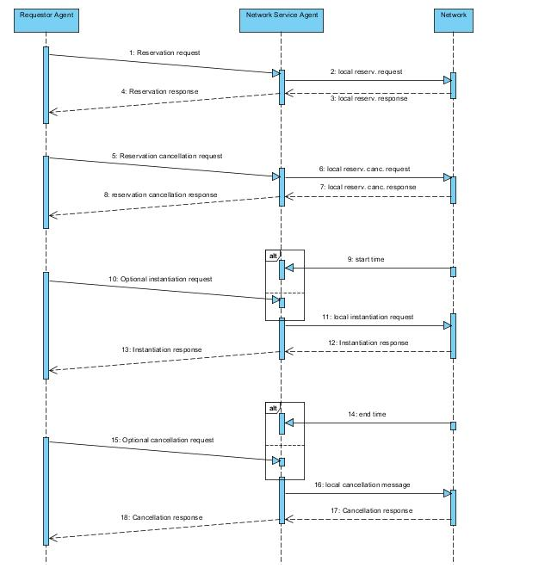
Use case 1:
single-domain
Message sequence diagram for single-domain reservation, instantiation and cancellation requests

Slide 3
Use case 1:
single-domain
Logic for local reservation request
Reservation request[id, route, attr]
route[endpt,(routingpts), endpt]
attr[perf, QoS, prot, time, user]
START[route, attr]
if both endpoints local, then LOCAL_RES_REQ[edgept, edgept, attr]
else RESPONSE[fail]
RESPONSE[localstate]
Reservation response[ state]
LOCAL_RES_REQ [edgept, edgept, attr]
Issue local reservation request
RESPONSE[localstate]
local reservation request[edgept, edgept, attr]
local reservation response[localstate]

Slide 4
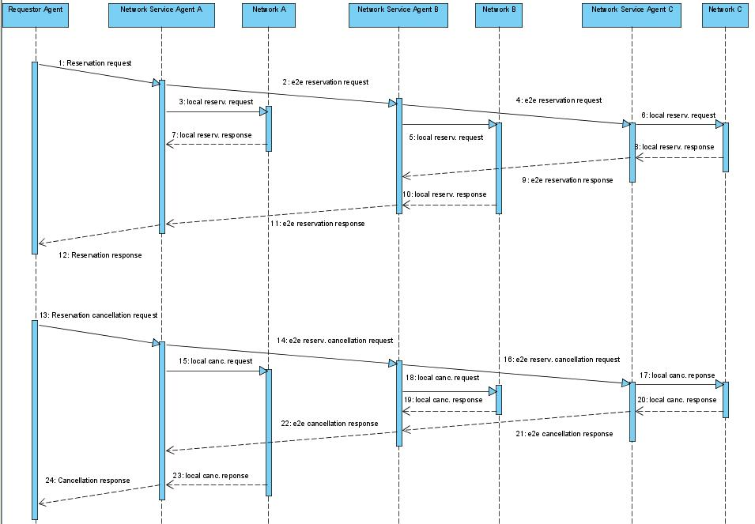
Use case 2: Message sequence diagram for multi-domain reservation requests, chain model

Slide 5
Use case 2: Logic for multi-domain reservation request using chain model
Reservation request[id, route, attr]
route[endpt,(routingpts), endpt]
attr[perf, QoS, prot, time, user]
START[route, attr]
Check endpts and routingpts against list of local addresses
If one or no routingpts and/or endpoints are local, PATHFIND[route]
if two routingpts and/or endpoints are local, then FORWARD[route,attr] or PATHFIND[route]
PATHFIND[route]
Perform pathfinding on route
Update route with new routingpts
if next hop found, FORWARD[route,attr]
else, RESPONSE[localsegment, fail]
e2e reserv. request[route, attr]
route[endpt,(routing pts), endpt]
attr[perf,QoS, prot, time, user]
FORWARD[route,attr]
If not last domain, then forward the connection request to the next domain
LOCAL_RES_REQ [routingpt, routingpt, attr]
For each incoming e2e reserv. Response RESPONSE[segment, state]
e2e reserv. Response[segment, state]
RESPONSE[segment, state]
Reservation response[ segment,state]
LOCAL_RES_REQ [routingpt, routingpt, attr]
Issue local reservation request
RESPONSE[local_segment, state]
local reservation request[edgept, edgept, attr]
local reservation response[localstate]

Slide 6
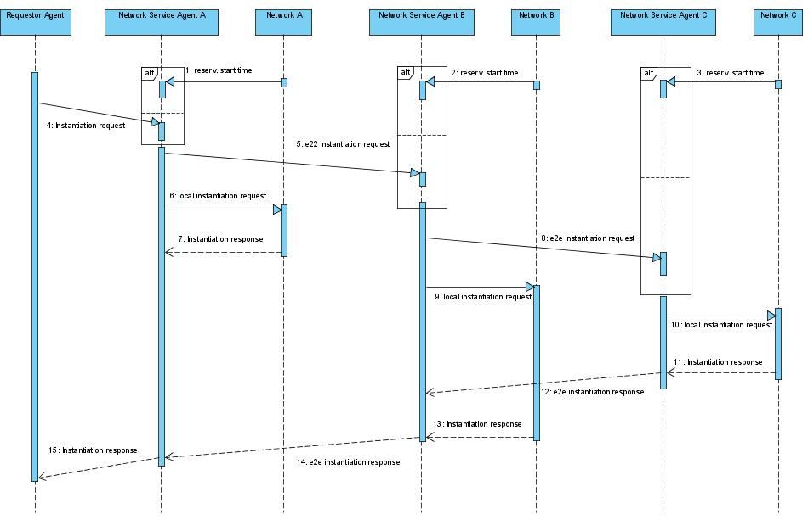
Use case: Message sequence diagram for multi-domain instantiation requests, chain model

Slide 7
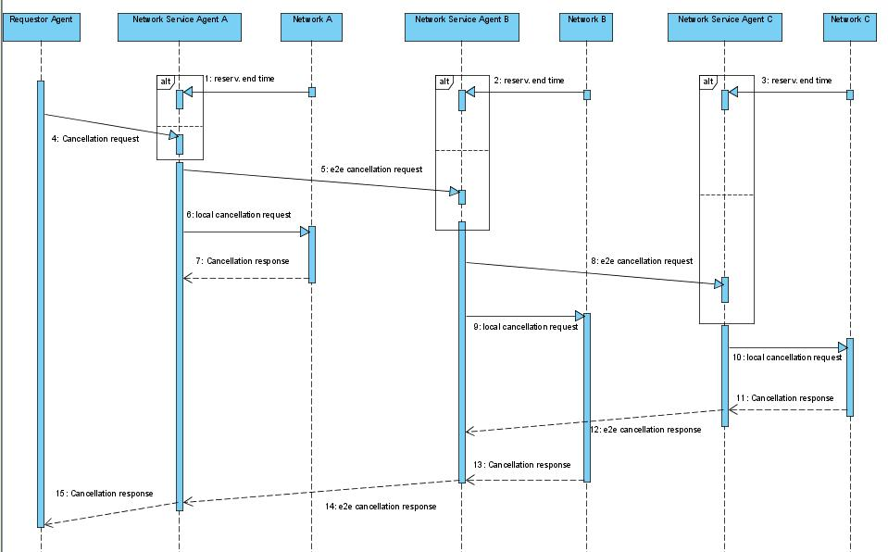
Use case 2: Message sequence diagram for multi-domain cancellation requests, chain model

Slide 8
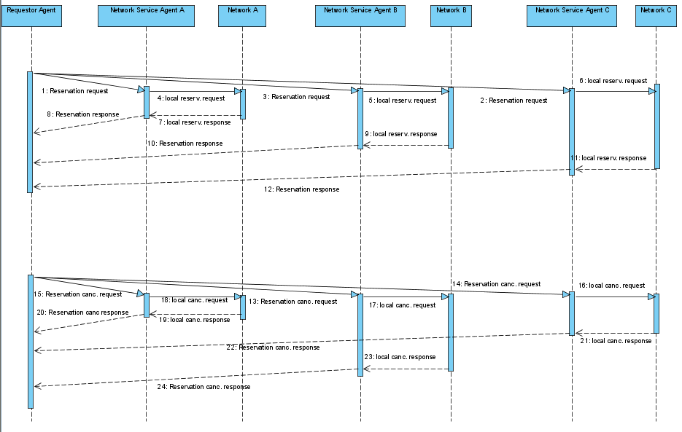
Use case 3: Message sequence diagram for multi-domain reservation requests, tree model

Slide 9
Use case 3: Logic for multi-domain reservation request using tree model
Reservation request[id, route, attr]
route[endpt,(routingpts), endpt]
attr[perf, QoS, prot, time, user]
START[route, attr]
Check endpts and routingpts against list of local addresses
If one or no routingpts and/or endpoints are local, PATHFIND[route]
if two routingpts and/or endpoints are local, then FORWARD[route,attr] or PATHFIND[route]
PATHFIND[route]
Perform pathfinding on route
Update route with new routingpts
if next hop found, FORWARD[route,attr]
else, RESPONSE[localsegment, fail]
e2e reserv. request[route, attr]
route[endpt,(routing pts), endpt]
attr[perf,QoS, prot, time, user]
FORWARD[route,attr]
If not last domain, then forward the connection request to ?
*** where to forward to without forwarding loops???***
LOCAL_RES_REQ [routingpt, routingpt, attr]
For each incoming e2e reserv. Response RESPONSE[segment, state]
e2e reserv. Response[segment, state]
RESPONSE[segment, state]
Reservation response[ segment,state]
LOCAL_RES_REQ [routingpt, routingpt, attr]
Issue local reservation request
RESPONSE[local_segment, state]
local reservation request[edgept, edgept, attr]
local reservation response[localstate]

