Slide 1
NSI Message handling and delivery
Feb. 6, 2013

Slide 2
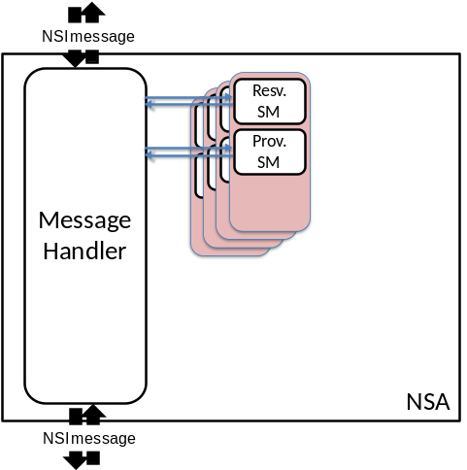
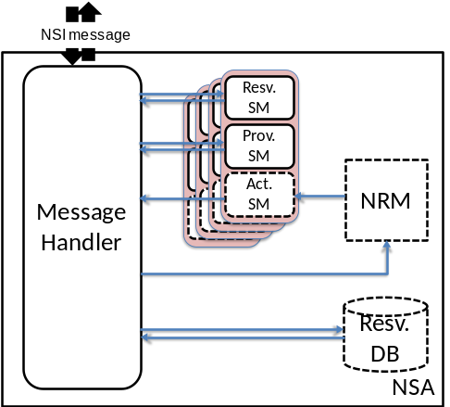
NSA: uRA, Aggregator and uPA
NSA
uRA
NSA
AG
NSA
NSA
uPA
AG
NRM
uPA
NRM

Slide 3
MTL and its API
Message Handler is a part of NSI stack, and uses MTL to send/receive messages
MTL API (for MH) includes:
  send: blocks until ack is returned by destination MTL, or timeout happens. Timeout value is implementation dependent
    MTL may re-try transmitting a message. Ack means the message is delivered “at least once”
  receive: a thread in MH is invoked when a message is received
NSI stack
Message Handler
Message Transport Layer

Slide 4
Message ack, reply and timeouts
: MTL timeout may happen
Requester
Provider
: MH timeout may happen
MH
MTL
MTL
MH
Ack is sent by MTL for each message
  If ack is not returned in a certain period of time, MTL timeout occurs
Reply is sent by MH and is either confirm, fail or not_applicable
  MH can timeout if expected reply is not received from a child
request
message
request
thread
blocked
return
ack
reply
message
thread
blocked
reply
return
ack
notification
message
thread
blocked
Notification
ack
ack
return

Slide 5
Timeouts
Message transport layer (MTL) timeout
  Underlying MTL (http/tcp) initiates a MTL timeout
  Happens when an ack is not returned for a message.
Message Handler (MH) timeout
  MH can timeout if a reply message is not returned in a certain period of time
MH notifies both MTL and MH timeouts to the parent RA
When a MTL/MH timeout is notified, uRA can either retry or terminate the connection.
  Retry is requested by NSI_messageRetry.rq, which has the original request message's id (correlation id) as a parameter
  MH keeps not-yet-replied requests in a table, so that it can re-send the request.

Slide 6
Tables an aggregator MH maintains for each reservation (connection)
FAIL_FLAG(cor)
CON
A
Z
Parameters
COR
FAIL_FLAG
CL(con)
RCV_LIST(cor)
NSA1
C_CON1
A1
Z1
Parameters1
RSM1
PSM1
ASM1
LSM1
C_COR1
STATUS1
NSA2
C_CON2
A2
Z2
Parameters2
RSM2
PSM2
ASM2
LSM2
C_COR2
STATUS2
NSAn
C_CONn
An
Zn
Parametersn
RSMn
PSMn
ASMn
LSMn
C_CORn
STATUSn
Expected states of children
including version info.
(for non-recursive queries)
Flags to indicate:
A reply has been received
A MTL timeout has occurred
A MH timeout has occurred
Generated for each reservation (connection)
Generated for
each request

