Slide 1


NSI signaling plane topology
An open discussion
John MacAuley

Slide 2
Problem Statement
Using data plane topology and path computation, a requestor NSA can determine the set of provider NSA that will need to be involved in a reservation request
Will the requester NSA have direct signaling plane peering to the complete set of provider NSA involved in the reservation?
If it does not, then how does the requester NSA propagate the reservation request such that it will be routed to the correct provider NSA associated with the data plane segment?

Slide 3
Peering Relationships
Not all NSA will be directly interconnected through a signaling plane peering relationship
NSA signaling plane topology does not need to be representative of data plane topology
Security and administration considerations will guide NSA inter-connectivity and not exclusively data plane considerations

Slide 4
Hierarchical Signaling Plane
Administrative policies will drive hierarchical signaling plane topologies
NSA will be deployed to manage a variety of networks including campus, regional, national, and international
We can expect administrators to build NSA signaling plane topologies similar to the administrative topologies constraining the data plane

Slide 5
User Requests
Users can request reservations from an NSA that is not directly managing resources in the data plane (Aggregator NSA)
This aggregator NSA may not have direct signaling plane peering with all the NSA involved on the reservation request
Users may request reservations between endpoints not in their network, or the network of their NSA
This implies the user request my not be originating from the NSA managing the source end of the data path

Slide 6

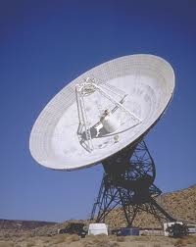
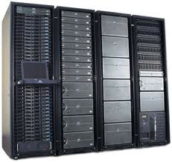
Reference Data Plane Topology
User
Community
Network I
Network G
Network H
Network F
Network A
Network B
Network C
Network D
Network E
STP A-1
STP E-1
Compute
Equipment
Scientific
Equipment

Slide 7

Reference Signaling Plane Topology
We want to connect the telescope to the image processing system
NSA I
NSA G
NSA F
NSA H
NSA A
NSA B
NSA C
NSA D
NSA E

Slide 8
Data Plane Path Selection
Network I
Network G
Network H
Network F
Network A
Network B
Network C
Network D
Network E
STP A-1
STP E-1
Segment | Network | NSA | Path
1 | A | A | STP A-1 -> STP A-G
2 | G | G | STP G-A -> STP G-F
3 | F | F | STP F-G -> STP F-H
4 | H | G | STP H-F -> STP H-E
5 | E | E | STP E-H -> STP E-1

Slide 9
Signaling Plane Topology
We want to connect the telescope to the image processing system
Aggregator
NSA I
2
3
4
NSA G
NSA F
NSA H
1
5
NSA A
NSA B
NSA C
NSA D
NSA E
Segment | Network | NSA | Path
1 | A | A | STP A-1 -> STP A-G
2 | G | G | STP G-A -> STP G-F
3 | F | F | STP F-G -> STP F-H
4 | H | H | STP H-F -> STP H-E
5 | E | E | STP E-H -> STP E-1

Slide 10
Simple Signaling Plane Path Finding
Perform data plane path finding computing the detailed path through the network
Build a directed graph using signaling plane topology
For each data plane segment compute the shortest path in signaling plane topology from root of NSI request (NSA I) to leaf NSA managing the target data path segment (NRM)
You now have the “potential” signaling path each request must take:
  Segment 1: I -> G ->A
  Segment 2: I -> G
  Segment 3: I -> G -> F
  Segment 4: I -> H
  Segment 5: I -> H -> E

Slide 11
Signaling Plane Topology
We want to connect the telescope to the image processing system
Aggregator
Segment 3
Segment 2
Segment 1
NSA I
2
3
NSA G
NSA F
NSA H
1
NSA A
NSA B
NSA C
NSA D
NSA E
Segment | Network | NSA | Path
1 | A | A | I -> G ->A
2 | G | G | I -> G
3 | F | F | I -> G -> F
4 | H | H | I -> H -> E
5 | E | E | I -> H -> E

Slide 12
Observations
In our current protocol definition each NSA receiving a reservation request will create a new reservation and maintain a corresponding state machine
Using this model NSA G will have three reservations for the single parent reservation
Any inaccuracies in signaling plane topology between NSA could result in routing loops
We have just increased the complexity of the protocol

Slide 13
Consolidated Path Request
Concept is to delegate request fan-out to lower in the NSA signaling tree (closer to leaf nodes)
Explicit Route Object (ERO) can be used to specify the exact STP to use in the connection request
Delegate the detailed path selection for lower down in the tree where data plane topology is contiguous

Slide 14
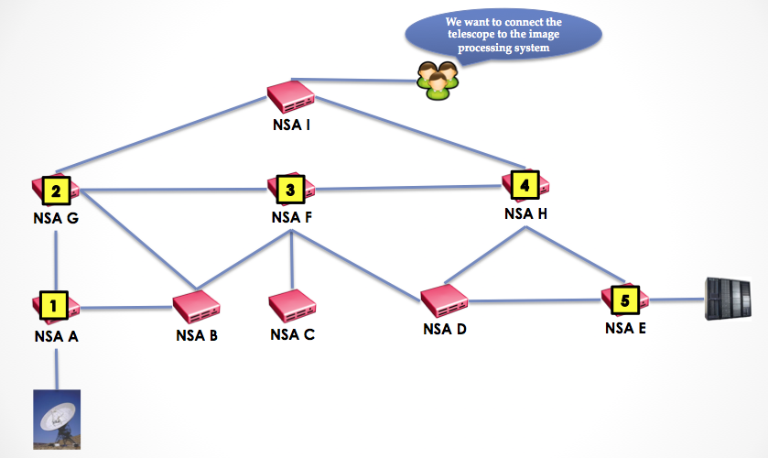
Explicit Route Object
Segment 5 is multiple hops away, is a child of NSA H managing segment 4, and is a contiguous data plane segment
Segments 1 and 3 are multiple hops away, are children of NSA G managing segment 2, and are contiguous data plane segments

Slide 15
Explicit Route Object
We can modify signaling plane path selection algorithms to favor using shared nodes higher in path that also contain segments contiguous at the data plane
Summarize requests for 1, 2, and 3 with a single request to NSA G with an explicit path:
  STP A-1 -> STP A-G, STP G-A -> STP G-F, STP F-G -> STP F-H
Summarize requests for 4 and 5 with a single request to NSA H with an explicit path
  STP H-F -> STP H-E, STP E-H -> STP E-1
Balance shortest path complexity versus reduced messaging and reduced reservation state machines

Slide 16
Path Selection Delegation
  Path finder computes loose data plane path and delegates detailed path computation lower in the tree
  Request for segments 1, 2, and 3 can be sent to NSA G as a single request for STP A-1 -> STP F-H
  Request for segments 4 and 5 can be sent to NSA H as a single request for STP H-F -> STP E-1
  Subset of ERO solution?

Slide 17
Simplifications
Can we require that NSA peering (signaling plane topology) follow data plane topology? NO
Can we require user reservation requests to be sent to the NSA managing the head-end STP? NO
With previous two constraints we can do chaining? NO since the previous two constraints are not met.
Can we require full NSA interconnection so a tree is only one level deep? NO

Slide 18
How do we solve the routing loop issue?
To rehash…
  Each parent NSA creates a new reservation for each child involved in the data plane path
  An NSA can receive a new reservation request as a child to a reservation it has already seen, however, it does not know they are related
Route recording within a reservation could solve the loop issue by explicitly recording the path a reservation segment takes down the tree
If the NSA is already in the list then it can assume a routing loop and reject the request

Slide 19
NSA connectedTo Attribute
<owl:NamedIndividual rdf:about="urn:ogf:network:nsa:netherlight">
<rdf:type rdf:resource="http://www.glif.is/working-groups/tech/dtox#NSA"/>
<rdfs:label xml:lang="en">netherlight</rdfs:label>
<managing rdf:resource="urn:ogf:network:nsnetwork:netherlight.ets" />
<connectedTo rdf:resource="urn:ogf:network:nsa:esnet" />
<connectedTo rdf:resource="urn:ogf:network:nsa:nordunet" />
<connectedTo rdf:resource="urn:ogf:network:nsa:czechlight" />
<adminContact rdf:datatype="http://www.w3.org/2001/XMLSchema#string">
3. OpenDRAC (SURFnet)
3.1. Implementation name: OpenDRAC
3.2. Proj Manager:
name: John MacAuley
email: john.macauley@surfnet.nl
phone: 1-613-220-6817 skype: john.macauley
3.3. Software Developer
name: John MacAuley
email: john.macauley@surfnet.nl
phone: 1-613-220-6817
skype: john.macauley
</adminContact>
<csProviderEndpoint rdf:datatype="http://www.w3.org/2001/XMLSchema#string">
http://dracproxy01.surfnet.nl:8080/nsi-v1/ConnectionServiceProvider
</csProviderEndpoint>
</owl:NamedIndividual>
We should also capture NSA role:
Provider, Aggregator, etc.

