Slide 1

Network Markup Language (NML)
OGF 40, Oxford

Slide 2
OGF IPR Policies Apply
“I acknowledge that participation in this meeting is subject to the OGF Intellectual Property Policy.”
Intellectual Property Notices Note Well:
All statements related to the activities of the OGF and addressed to the OGF are subject to all provisions of Appendix B of GFD-C.1, which grants to the OGF and its participants certain licenses and rights in such statements. Such statements include verbal statements in OGF meetings […]
Excerpt from Appendix B of GFD-C.1:
”Where the OGF knows of rights, or claimed rights, the OGF secretariat shall attempt to obtain from the claimant of such rights, a written assurance that upon approval by the GFSG of the relevant OGF document(s), any party will be able to obtain the right to implement, use and distribute the technology or works when implementing, using or distributing technology based upon the specific specification(s) under openly specified, reasonable, non-discriminatory terms. The working group or research group proposing the use of the technology with respect to which the proprietary rights are claimed may assist the OGF secretariat in this effort. The results of this procedure shall not affect advancement of document, except that the GFSG may defer approval where a delay may facilitate the obtaining of such assurances. The results will, however, be recorded by the OGF Secretariat, and made available. The GFSG may also direct that a summary of the results be included in any GFD published containing the specification.” “If you did read this, you accept a free drink from Freek”
Notes:
IPR Notices Note Well for OGF meetings

Slide 3
Agenda
NML base (proposed) changes
Identifiers
Future documents
Future of the NML-WG
NSI Topology Exchange (John & Chin)
NSI for a data center

Slide 4
(Proposed) Changes in NML
OGF 40, Oxford

Slide 5
Proposed Changes
Schema fixes for libxml2
Add labelType attribute to SwitchingService
Ports with different labels in a SwitchingService
AdaptationService between two PortGroups / SwitchingServices
Capacity, MTU, cost metric
Notes:
NML base: GFD.206 (May 2013)

Slide 6
Schema fixes for libxml2/xmllint
<xs:complexType name="SwitchingServiceType">
<xs:complexContent>
<xs:extension base="nml:NetworkObject">
<xs:sequence>
<xs:element name="Relation" type="nml:SwitchingServiceRelationType” minOccurs="0" maxOccurs="unbounded"/>
<xs:any namespace="##other" processContents="lax" minOccurs="0" maxOccurs="unbounded"/>
</xs:sequence>
<xs:attribute name="encoding" type="xs:anyURI" use="optional"/>
<xs:attribute name="labelSwapping" type="xs:boolean" use="optional"/>
<xs:attribute name="labelType" type="xs:anyURI" use="optional"/>
</xs:extension>
</xs:complexContent>
</xs:complexType>
Notes:
What about ##local on the line before ##other?

Slide 7
labelType attribute for SwitchingService
<xs:complexType name="SwitchingServiceType">
<xs:complexContent>
<xs:extension base="nml:NetworkObject">
<xs:sequence>
<xs:element name="Relation" type="nml:SwitchingServiceRelationType” minOccurs="0" maxOccurs="unbounded"/>
<xs:any namespace="##other" processContents="lax" minOccurs="0" maxOccurs="unbounded"/>
</xs:sequence>
<xs:attribute name="encoding" type="xs:anyURI" use="optional"/>
<xs:attribute name="labelSwapping" type="xs:boolean" use="optional"/>
<xs:attribute name="labelType" type="xs:anyURI" use="optional"/>
</xs:extension>
</xs:complexContent>
</xs:complexType>
Notes:
Can this work with next proposed change?

Slide 8
Different labelType in SwitchingService
encoding := frame format
e.g. Ethernet, SDH, WDM)
labeltype := channel identifier type
e.g. C-VLAN, S-VLAN, or I-SID for Ethernet
e.g. K, L, M, or U label for SDH
e.g. wavelength (CWDM), or frequency (DWDM) for WDM.
1:∞ relation between encoding:label

Slide 9
Different labelType in SwitchingService
Example: Ethernet switch with tagged (802.1q label) and untagged (no label) Ports.
label-Swapping | Meaning
false | Both label and labeltype must match
true | All Ports can exchange data; no restriction with regard to label type or value

Slide 10
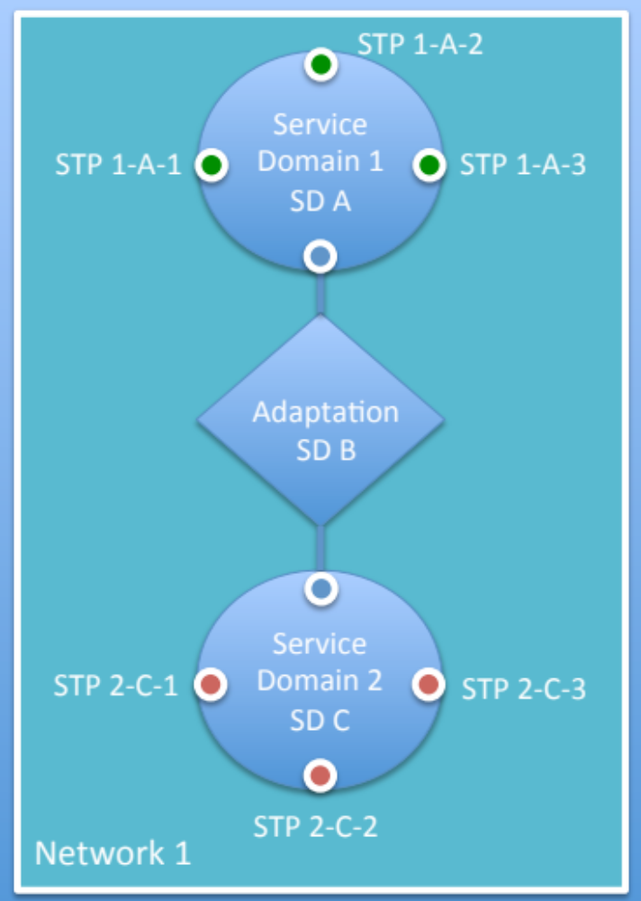
AdaptationService
Now:
Port → AdaptationService → PortGroup
Proposed:
PortGroup → AdaptationService → PortGroup

Slide 11
Capacity
Suggested, along with MTU and cost metric.
Not in NML-base. Perhaps in NML Ethernet extension.

Slide 12
How to proceed?
Changes currently in nsi-wg-topology repository
https://redmine.ogf.org/projects/nsi-wg-topology/repository/revisions/master/show/schemas
Must be made into a NML 1.1 update
Volunteers after NSI-TS (NSI Topology Service) publication

Slide 13
Identifiers: From Port ID to NSA URL
OGF 40, Oxford

Slide 14
Outline
Heated discussion between Henrik, Jeroen and myself in Dec 2013.
Problem: how to get from a Port identifier to a Topology, and NSA*?
* The Network Service Agent, not your National Spying Atrocity
Notes:
General; Previous; Current; Problem; NORDUnet proposal; Freek proposal; Topology Distribution; Future

Slide 15
General
GFD.206 (NML-base): schema. Allows all URI as identifiers. not just urn:ogf:network:*.
GFD.202: defines urn:ogf:network identifiers:
<PREFIX>:<ID-OF-ASSIGNING-ORG>:<LOCAL PART>
  <PREFIX> := 'urn:ogf:network’
  <ID-OF-ASSIGNING-ORG> := domain + ":" + date
Topology exchange not part of NML schema
NML is liberal
NSI may need restrictions on NML

Slide 16
Previously
STP := triplet
(Topology ID, source PortGroup ID, sink PortGroup ID)
This works, but is not very pretty.
Problem: isAlias only points to a Port, not a Topology.

Slide 17
Current
STP := single NML Port identifier
Triplet is not used anymore
Note: draft-gwdi-nsi-topology-service is not yet updated to reflect this change.
draft-gwdrp-nsi-topology-representation is up-to-date.

Slide 18
Problem
How to get from a NML Port identifier to a Topology
How to get from a Topology to a NSA
Current solution: AutoGOLE is using a bootstrap file to make these mappings.
AutoGOLE solution does not scale, in particular if Topology and Port identifiers are in different namespaces.
e.g.:
Topology `http://some.example.org/our-network` hasOutboundPort
Port `urn:ogf:network:other.example.net:2013:port-12345`

Slide 19
NORDUnet Proposal
Topology identifier is created by appending the organisation prefix must start with the word ‘Topology’
e.g.:
Port `urn:ogf:network:example.net:2013:port:12345`
Topology `urn:ogf:network:example.net:2013:Topology`
Solves Port → Topology mapping
Requires AutoGOLE bootstrap file, or Topology distribution service for Topology → NSA
Notes:
By Lars Fischer and Henrik

Slide 20
Knights-of-the-URNs Proposal
If and only if a strict Port ⟷ Topology mapping is necessary (besides the Port → prefix mapping):
Assigning organisation prefix must be the same for Topology and the Ports it contains.
e.g.:
Topology `urn:ogf:network:example.net:2013:network`
Port `urn:ogf:network:example.net:2013:port-12345`
Considered better than e.g.:
Topology `urn:ogf:network:example.net:2013:network`
Port `urn:ogf:network:example.net:2013:network:port-12345`
Notes:
By Freek and Jeroen

Slide 21
Knights-of-the-URNs Proposal
Only use urn:ogf:network identifiers
  This ensures a Port identifier → Prefix mapping
e.g.:
Port `urn:ogf:network:example.net:2013:network`
prefix `urn:ogf:network:example.net:2013`
Solves Port → prefix mapping
Requires AutoGOLE bootstrap file, or Topology lookup service for prefix → NSA and prefix → Topology mapping
Notes:
By Freek and Jeroen

Slide 22
Topology Distribution
from draft-gwdi-nsi-topology-service:
Centralized Manual Distribution
Version Controlled Distribution (AutoGOLE GitHub)
(PerfSonar) Lookup Service
HTTP Distribution (hop by hop traversal)
A Peer-to-Peer Distribution Protocol
Notes:
ESnet has SLS = Simple Lookup Service
A Key-value store implemented using MongoDB.

Slide 23
Future
Prefix → NSA mapping still needs to be solved
Freek thinks a lookup service is best solution
Jeroen (also) prefers a peer-to-peer solution
Handle system (lookup service) would have been perfect
If Freek would to things over, he'd have used the Handle system (DNS on steroids)
Handle and DNS: lookup service, root & delegation.
URN: lookup service defined (RFC 3402), not used
Simple Lookup Service by ESnet?
Notes:
Handle: RFC 3651. Example: hdl.handle.net with or 10.5240/5868-409E-7BFB-536A-6067-E

Slide 24
Intermezzo: The Handle System
RFC 6531, ISO 26324
General resolvers: hdl.handle.net, dx.doi.org
Identifier | Resolver | Resource
10.5240/5868-409E-7BFB-536A-6067-E | resolve.eidr.org | Movie database
10.1016/j.future.2006.03.007 | sciencedirect.com | Scientific publication
2333.1/v9s4mww5 |  | Files
10916/58405ca4-1f31-11e2-ba9d-14feb57d1255 | epic.sara.nl | Scientific data

Slide 25
Identifiers: From Port ID to NSA URL
Overview of Solutions

Slide 26
Problem
How to get from a NML Port identifier to a Topology
How to get from a NML Port identifier to a NSA
Notes:
Handle: RFC 3651. Example: hdl.handle.net with or 10.5240/5868-409E-7BFB-536A-6067-E

Slide 27
Use Cases
...
NORDUnet: split network in two parts with other Topology ID
SURFnet: move a Port from testbed to production network
...
Notes:
Handle: RFC 3651. Example: hdl.handle.net with or 10.5240/5868-409E-7BFB-536A-6067-E

Slide 28
Assumptions
Port and Topology must use urn:ogf:network identifiers.
Notes:
Handle: RFC 3651. Example: hdl.handle.net with or 10.5240/5868-409E-7BFB-536A-6067-E

Slide 29
Proposal 1 (Henrik)
string rewrite
string rewrite
Port ID
Topology ID
NSA URL
extract prefix and add the word 'Topology'
build by distribute reachability between peers
Limitations
Port can't move to another Topology later
Max 1 Topology ID and 1 NSA per prefix
(work-around: further interpretation of the URN)
Organisations can't freely pick their Topology identifier
NSAs need database with all Topology IDs
Notes:
Handle: RFC 3651. Example: hdl.handle.net with or 10.5240/5868-409E-7BFB-536A-6067-E

Slide 30
Proposal 2 (Freek)
extract
lookup service
NSA URL
Port ID
prefix
Topology ID
lookup by prefix in global lookup service (gLS)
Limitations
Port can't move to another Topology later
Max 1 Topology ID and 1 NSA per prefix
(work-around: multiple prefixes per organisation)
Notes:
Handle: RFC 3651. Example: hdl.handle.net with or 10.5240/5868-409E-7BFB-536A-6067-E

Slide 31
Proposal 3 (Freek)
extract
Port ID
prefix
global lookup service
lookup by prefix in global lookup service (gLS)
home lookup service
NSA URL
home lookup service URL
Topology ID
lookup by Port ID in home lookup service (hLS)
Limitations
Lookup per Port ID, instead of per prefix or per Topology
Advantage
Easier to extend to non-URN:OGF:network identifiers
Notes:
Handle: RFC 3651. Example: hdl.handle.net with or 10.5240/5868-409E-7BFB-536A-6067-E

Slide 32
Future Documents
OGF 40, Oxford

Slide 33
Future documents
NSI Topology Representation: Jeroen, John
Topology Distribution Mechanisms: Jeroen (done)
Topology Distribution Specification: Henrik, Chin (possibly different proposals)
Changes to NML-base: Freek
Experience Document: postpone to later
JSON syntax: contributions welcome
Ethernet extensions: John, Freek
IP extensions: contributions welcome
OpenFlow extensions: Radek, Lucas, Diederik, Miroslav
Experimental Features: Freek
AutoGOLE NSI-CS sci paper: Miroslav (UvA)

